Slide 1
Joining tables – other join types

Slide 2
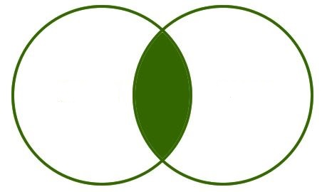
Inner join (REstrictions)
SELECT ename, name, job
FROM emp e
INNER JOIN customer c ON c.repid = e.empno;
This query will only return employees that are a sales representative for a customer (i.e. job = SALESMAN).
EMP
CUSTOMER

Slide 3
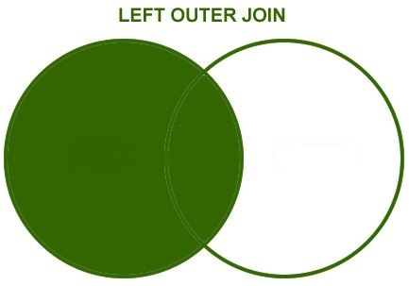
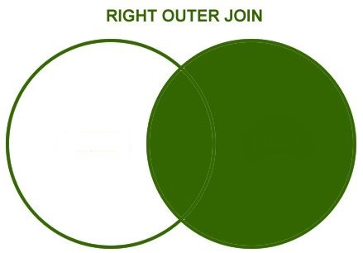
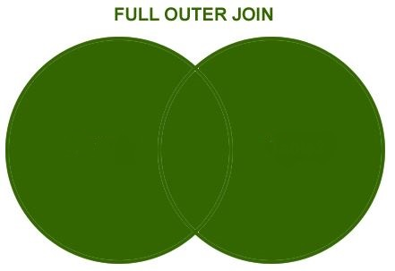
OUTER JOINs
Question: How would you display:
All employees irrespective of whether they were a representative for a customer or not?
Answer: Use a LEFT OUTER JOIN
All customers irrespective of whether they had a sales rep associated with them or not?
Answer: Use a RIGHT OUTER JOIN
Both of the above?
Answer: Use a FULL OUTER JOIN
EMP
CUSTOMER
EMP
CUSTOMER
EMP
CUSTOMER

Slide 4
OUTER JOINs IN SQLITE
Note: Although some database vendors have implemented all three outer join types, SQLite has only implemented LEFT OUTER JOIN but there are ways to simulate a RIGHT OUTER JOIN and FULL OUTER JOIN as illustrated in the following slides

Slide 5
Left OUTER JOIN example
SELECT ename AS REP_NAME, name AS CUST_NAME
FROM emp e
LEFT OUTER JOIN customer c ON c.repid = e.empno
ORDER BY ename;
Displays all employees irrespective of whether they are a customer rep or not. Because emp is on the left hand side of the join

Slide 6
Left OUTER JOIN example
Query result:
REP_NAME | CUST_NAME
ADAMS | NULL
ALLEN | EVERY MOUNTAIN
ALLEN | WOMENS SPORTS
BLAKE | NULL
CLARK | NULL
FORD | NULL
JAMES | NULL
JONES | NULL
KING | NULL
MARTIN | TKB SPORT SHOP
MARTIN | VOLLEYRITE
MILLER | NULL
SCOTT | NULL
SMITH | NULL
TURNER | JOCKSPORTS
TURNER | K + T SPORTS
TURNER | NORTH WOODS HEALTH AND FITNESS SUPPLY CENTRE
WARD | JUST TENNIS
WARD | SHAPE UP

Slide 7
Simulating a right OUTER JOIN
SELECT ename AS REP_NAME, name AS CUST_NAME
FROM customer c
LEFT OUTER JOIN emp e ON e.empno = c.repid
ORDER BY ename;
As RIGHT-OUTER JOIN is not available in SQLite, we simulate it by putting the customer on the left hand side of the join and using LEFT OUTER JOIN. Displays all customers irrespective of whether they have a employee representative or not.
Query result:
REP_NAME | CUST_NAME
NULL | KW SPORTS
ALLEN | EVERY MOUNTAIN
ALLEN | WOMENS SPORTS
MARTIN | TKB SPORT SHOP
MARTIN | VOLLEYRITE
TURNER | JOCKSPORTS
TURNER | K + T SPORTS
TURNER | NORTH WOODS HEALTH AND FITNESS SUPPLY CENTRE
WARD | JUST TENNIS
WARD | SHAPE UP

Slide 8
Simulating a full OUTER JOIN
SELECT ename AS REP_NAME, name AS CUST_NAME
FROM emp e
LEFT OUTER JOIN customer c ON c.repid = e.empno
UNION
SELECT ename AS REP_NAME, name AS CUST_NAME
FROM customer c
LEFT OUTER JOIN emp e ON e.empno = c.repid;
As FULL OUTER JOIN is not available in SQLite, we simulate it by using UNION to merge the two previous queries together ensuring that we select the same columns in the same order in both queries.
This will display all employees irrespective of whether they are a customer rep or not and all customers irrespective of whether they have a employee representative or not.

Slide 9
Simulating a full OUTER JOIN
Query result:
REP_NAME | CUST_NAME
NULL | KW SPORTS
ADAMS | NULL
ALLEN | EVERY MOUNTAIN
ALLEN | WOMENS SPORTS
BLAKE | NULL
CLARK | NULL
FORD | NULL
JAMES | NULL
JONES | NULL
KING | NULL
MARTIN | TKB SPORT SHOP
MARTIN | VOLLEYRITE
MILLER | NULL
SCOTT | NULL
SMITH | NULL
TURNER | JOCKSPORTS
TURNER | K + T SPORTS
TURNER | NORTH WOODS HEALTH AND FITNESS SUPPLY CENTRE
WARD | JUST TENNIS
WARD | SHAPE UP

Slide 10
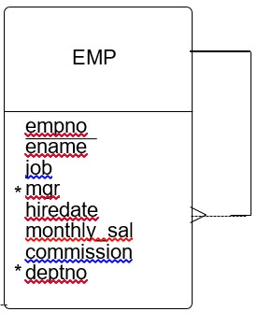
self JOIN
Sometimes it is necessary to join a table to itself e.g. in order to display a list of all employees and the name of their manager.

Slide 11
Self join example
SELECT e.ename AS “Employee Name”, e.job AS “Employee Job”, m.ename AS “Manager Name”, m.job AS “Manager Job”
FROM emp e
INNER JOIN emp m ON m. empno = e.mgr;
A self-join is like joining a table to a copy of itself. In the above example e is the alias for the emp table to retrieve the employee’s details and m is the alias for the copy of the emp table to retrieve the manager’s details.
Query result:
Employee Name | Employee Job | Manager Name | Manager Job
SMITH | CLERK | FORD | ANALYST
ALLEN | SALESMAN | BLAKE | MANAGER
WARD | SALESMAN | BLAKE | MANAGER
JONES | MANAGER | KING | PRESIDENT
MARTIN | SALESMAN | BLAKE | MANAGER
BLAKE | MANAGER | KING | PRESIDENT
CLARK | MANAGER | KING | PRESIDENT
SCOTT | ANALYST | JONES | MANAGER

Slide 12
Self join example
The statement above will display all the employees except the PRESIDENT (who has no manager) so to display him as well, we need to use a LEFT OUTER (SELF) JOIN as follows:
SELECT e.ename AS ‘Employee Name’, e.job AS ‘Employee Job’, m.ename AS ‘Manager Name’, m.job AS ‘Manager Job’
FROM emp e
LEFT OUTER JOIN emp m ON m. empno = e.mgr;
Query result:
Employee Name | Employee Job | Manager Name | Manager Job
SMITH | CLERK | FORD | ANALYST
ALLEN | SALESMAN | BLAKE | MANAGER
WARD | SALESMAN | BLAKE | MANAGER
JONES | MANAGER | KING | PRESIDENT
MARTIN | SALESMAN | BLAKE | MANAGER
BLAKE | MANAGER | KING | PRESIDENT
CLARK | MANAGER | KING | PRESIDENT
SCOTT | ANALYST | JONES | MANAGER
KING | PRESIDENT | NULL | NULL

Slide 13
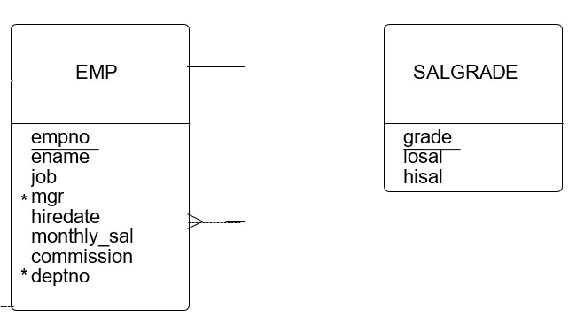
Non-equi joiN
All the previous joins we’ve looked at use equal values in two tables. Occasionally, we need to use operators other than equal such as a value in one table belonging to a range in another table. This is called a NON-EQUI JOIN.
We want to display the monthly salary and salary grade for each employee. The salgrade table holds salary ranges for each grade so we have to join emp to salgrade but there is no relationship between the two tables.

Slide 14
Non-equi join example
SELECT ename, monthly_sal, grade
FROM emp e
INNER JOIN salgrade s ON e.monthly_sal BETWEEN s.losal AND s.hisal
Query result:
ENAME | MONTHLY_SAL | GRADE
SMITH | 800 | 1
ALLEN | 1600 | 3
WARD | 1250 | 2
JONES | 2975 | 4
MARTIN | 1250 | 2
BLAKE | 2850 | 4
CLARK | 2450 | 4
SCOTT | 3000 | 4
KING | 5000 | 5
TURNER | 1500 | 3
ADAMS | 1100 | 1
JAMES | 950 | 1
FORD | 3000 | 4
MILLER | 1300 | 2

